Slide 1

Geometry
Unit 1, Lesson 7 Congruence and Similarity Volume 1, pg. 40

Slide 2


Benchmarks
MA.912.GR.2.6
Apply rigid transformations to map one figure onto another to justify that the two figures are congruent.
MA.912.GR.2.8
Apply an appropriate transformation to map one figure onto another to justify that the two figures are similar.
volume 1, pg. 40

Slide 3
Integrated Mathematical Thinking and Reasoning Standards
MA.K12.MTR.1.1 Actively participate in effortful learning both individually and collectively.
MA.K12.MTR.2.1 Demonstrate understanding by representing problems in multiple ways.
MA.K12.MTR.4.1 Engage in discussions that reflect on the mathematical thinking of self and others.
MA.K12.MTR.5.1 Use patterns and structure to help understand and connect mathematical concepts.
volume 1, pg. 40

Slide 4

Learning Targets
I can recognize the relationship between corresponding sides and corresponding angles of congruent and similar figures.
I can write congruence statements to relate corresponding parts following a rigid transformation.
I can write similarity statements to relate corresponding parts following a dilation.
volume 1, pg. 40

Slide 5

Warm-Up
volume 1, pg. 41

Slide 6
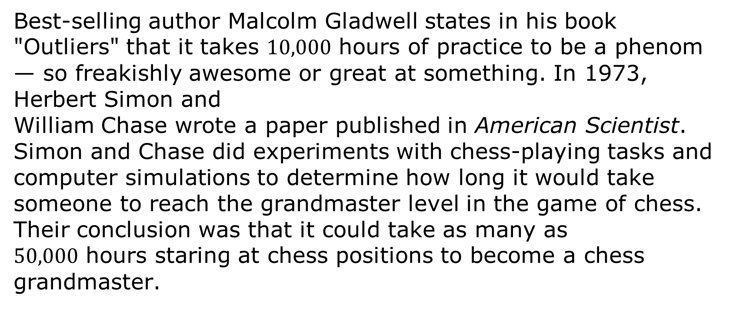
1.7.1 Warm-Up: 10,000 Hours to Awesome
Best-selling author Malcolm Gladwell states in his book "Outliers" that it takes $10,000$ hours of practice to be a phenom — so freakishly awesome or great at something. In 1973, Herbert Simon and William Chase wrote a paper published in American Scientist. Simon and Chase did experiments with chess-playing tasks and computer simulations to determine how long it would take someone to reach the grandmaster level in the game of chess. Their conclusion was that it could take as many as $50,000$ hours staring at chess positions to become a chess grandmaster.
volume 1, pg. 41

Slide 7
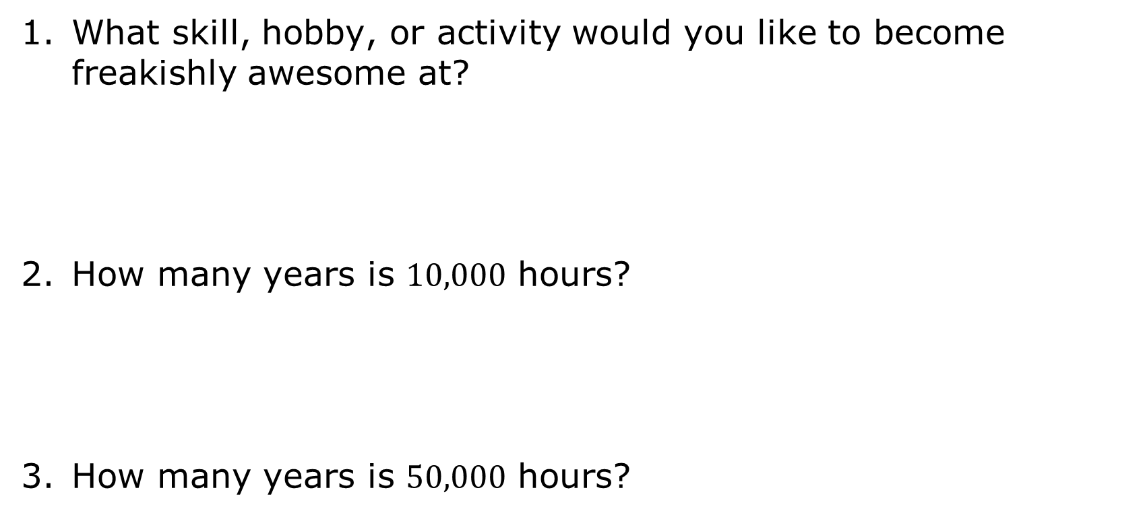
What skill, hobby, or activity would you like to become freakishly awesome at?
How many years is $10,000$ hours?
How many years is $50,000$ hours?
volume 1, pg. 41

Slide 8

Collaboration
volume 1, pg. 41

Slide 9

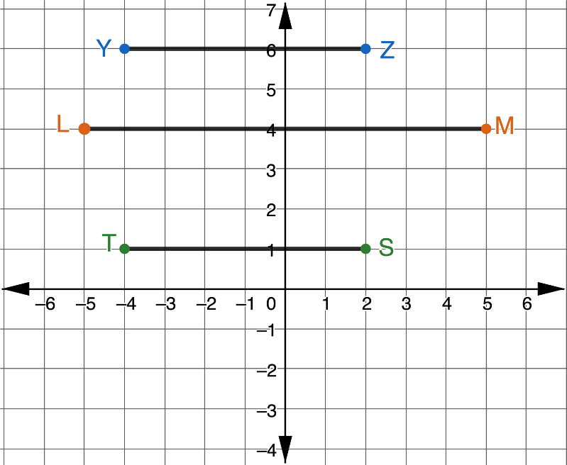
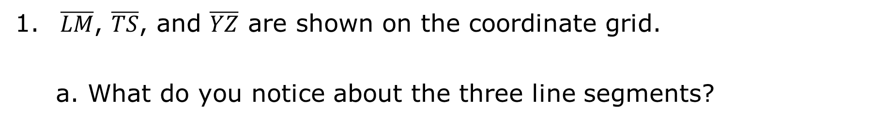
1.7.2 Collaboration: Line Segments
$\overline{LM}$, $\overline{TS}$, and $\overline{YZ}$ are shown on the coordinate grid.
What do you notice about the three line segments?
volume 1, pg. 41

Slide 10
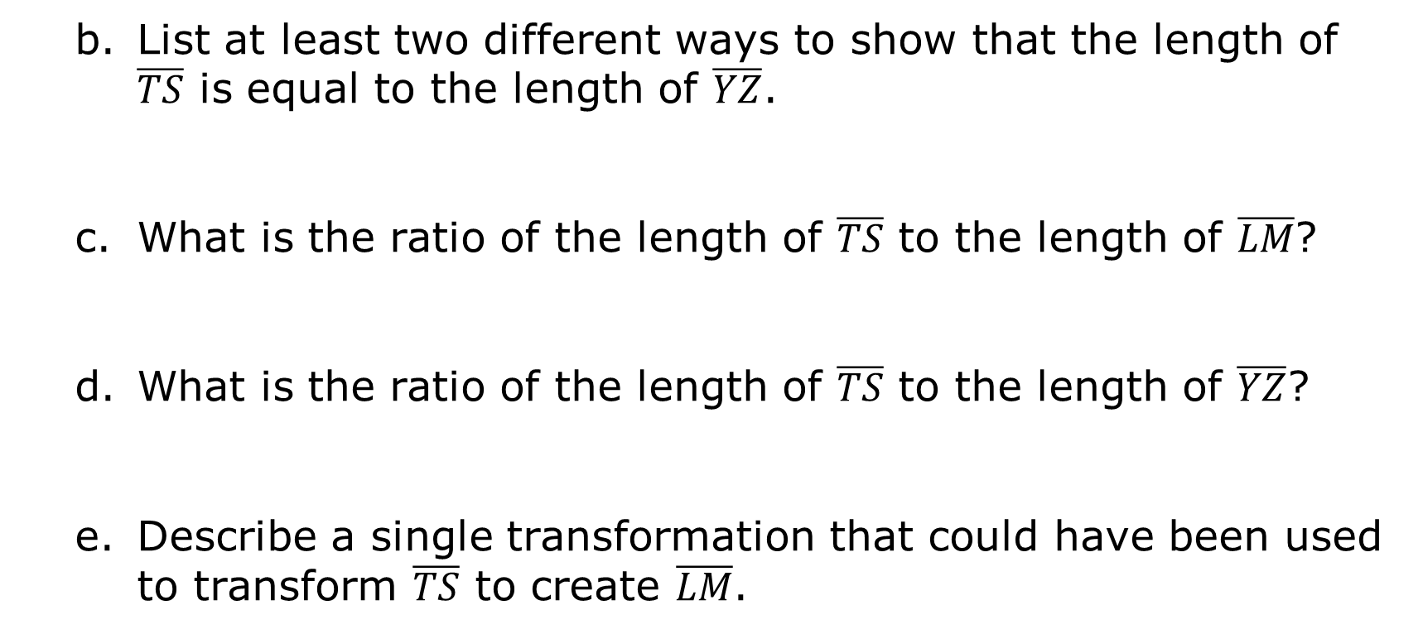
List at least two different ways to show that the length of $\overline{TS}$ is equal to the length of $\overline{YZ}$.
What is the ratio of the length of $\overline{TS}$ to the length of $\overline{LM}$?
What is the ratio of the length of $\overline{TS}$ to the length of $\overline{YZ}$?
Describe a single transformation that could have been used to transform $\overline{TS}$ to create $\overline{LM}$.
volume 1, pg. 42

Slide 11
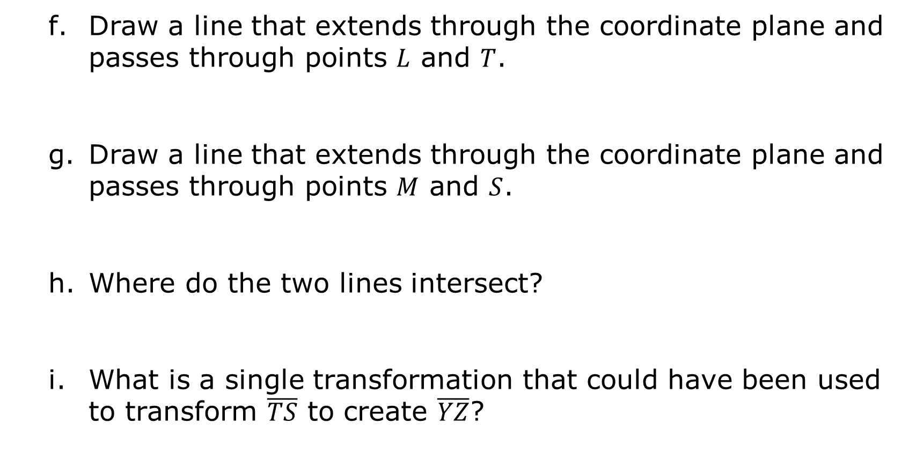
Draw a line that extends through the coordinate plane and passes through points $L$ and $T$.
Draw a line that extends through the coordinate plane and passes through points $M$ and $S$.
Where do the two lines intersect?
What is a single transformation that could have been used to transform $\overline{TS}$ to create $\overline{YZ}$?
volume 1, pg. 42

Slide 12
Ask two classmates the transformation they selected. Record their transformation and write your summary of their reason. You are the only person who should write in the first two columns of the table. Have the person initial next to your summary stating that your summary was correct.
Transformation | My Summary of Their Reason | Initials
volume 1, pg. 42

Slide 13
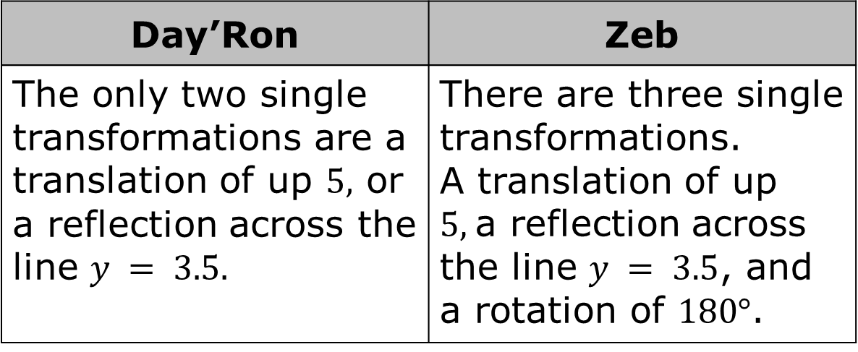
Day’Ron and Zeb were discussing how to transform $\overline{TS}$ to create $\overline{YZ}$.
Day’Ron | Zeb
The only two single transformations are a translation of up $5,$ or a reflection across the line $y = 3.5.$ | There are three single transformations. A translation of up $5,$a reflection across the line $y = 3.5$, and a rotation of $180°$.
volume 1, pg. 43

Slide 14
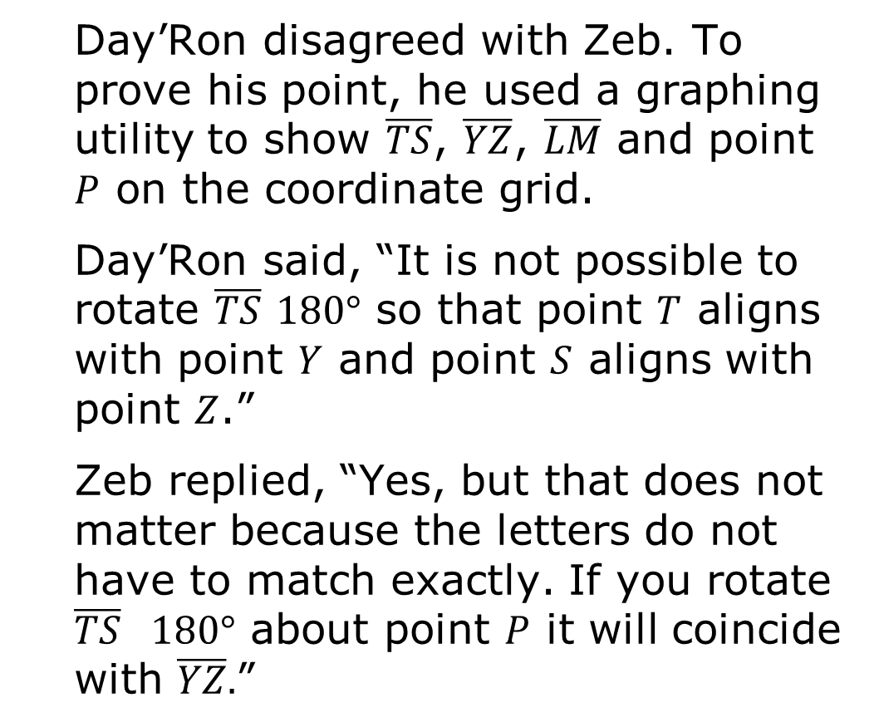
Day’Ron disagreed with Zeb. To prove his point, he used a graphing utility to show $\overline{TS}$, $\overline{YZ}$, $\overline{LM}$ and point $P$ on the coordinate grid.
Day’Ron said, “It is not possible to rotate $\overline{TS}$ $180°$ so that point $T$ aligns with point $Y$ and point $S$ aligns with point $Z$.”
Zeb replied, “Yes, but that does not matter because the letters do not have to match exactly. If you rotate $\overline{TS}$ $180°$ about point $P$ it will coincide with $\overline{YZ}.$”
volume 1, pg. 43

Slide 15
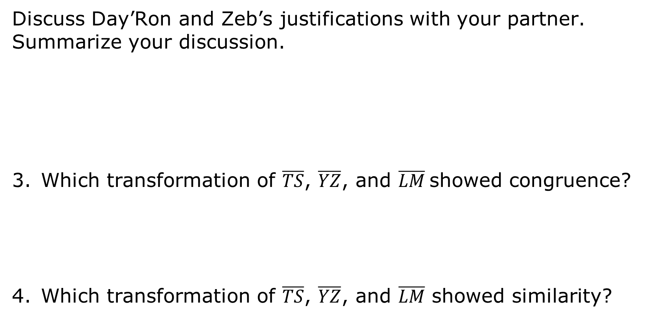
Discuss Day’Ron and Zeb’s justifications with your partner. Summarize your discussion.
Which transformation of $\overline{TS}$, $\overline{YZ}$, and $\overline{LM}$showed congruence?
Which transformation of $\overline{TS}$, $\overline{YZ}$, and $\overline{LM}$ showed similarity?
volume 1, pg. 43

Slide 16

Guided Practice
volume 1, pg. 44

Slide 17

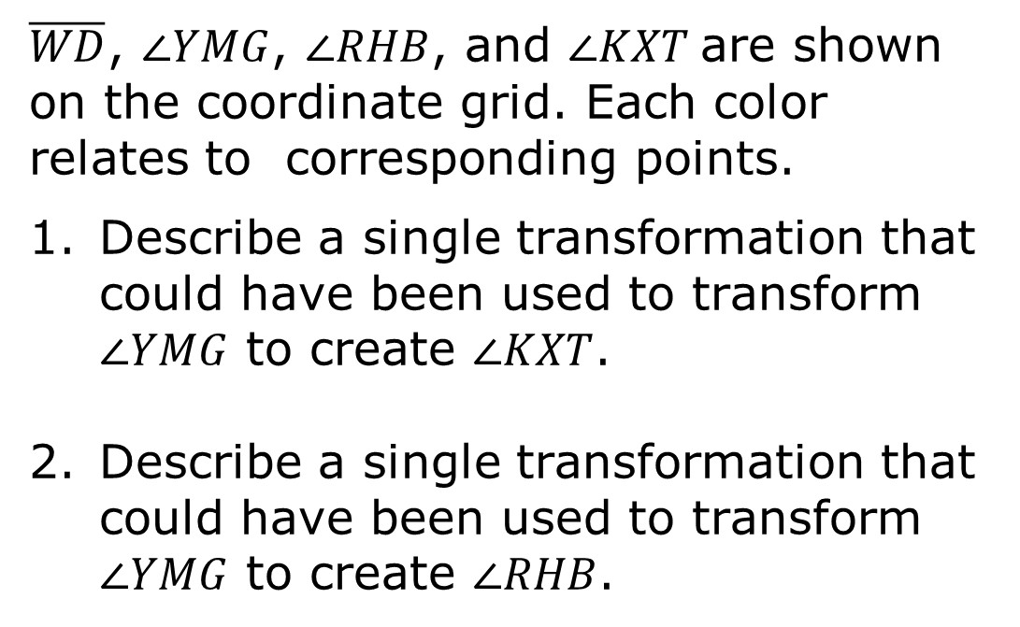
1.7.3 Guided Practice: Angles
$\overline{WD}$, $∠YMG$, $∠RHB$, and $∠KXT$are shown on the coordinate grid. Each color relates to corresponding points.
Describe a single transformation that could have been used to transform $∠YMG$ to create $∠KXT$.
Describe a single transformation that could have been used to transform $∠YMG$ to create $∠RHB$.
volume 1, pg. 44

Slide 18
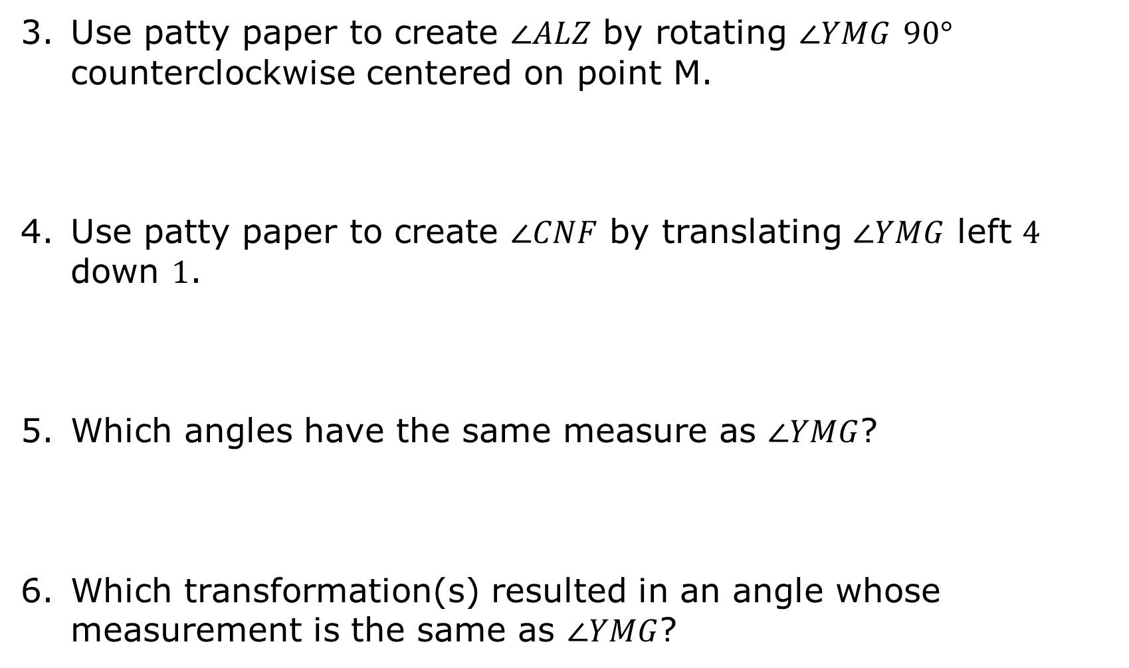
Use patty paper to create $∠ALZ$ by rotating $∠YMG$ $90°$ counterclockwise centered on point M.
Use patty paper to create $∠CNF$ by translating $∠YMG$ left $4$ down $1$.
Which angles have the same measure as $∠YMG$?
Which transformation(s) resulted in an angle whose measurement is the same as $∠YMG$?
volume 1, pg. 44

Slide 19

Bring It Together
volume 1, pg. 45

Slide 20

1.7.4 Bring It Together: Congruence and Similarity
Complete the statements.
A rigid transformation results in a line segment that congruent to the original line segment.
A dilation results in a line segment that congruent to the original line segment.
A rigid transformation results in an angle that congruent to the original angle.
A dilation results in an angle that congruent to the original angle.
is
is not
is
is not
is
is not
is
is not
volume 1, pg. 45

Slide 21


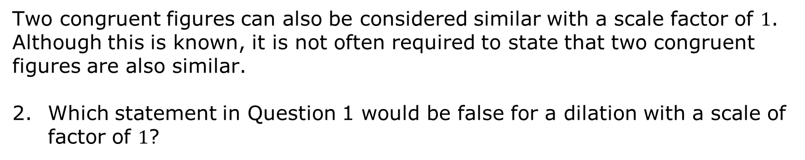
Two figures are congruent if they have exactly the same shape and size. Equivalently, two figures are congruent if one figure can be mapped to the other using a single rigid motion, or a sequence of transformations that includes only rigid motions.
Similarity is having exactly the same shape but not necessarily the same size. Two figures are similar if and only if one figure can be obtained from the other by a dilation, or a sequence of transformations that includes a dilation.
Two congruent figures can also be considered similar with a scale factor of $1$. Although this is known, it is not often required to state that two congruent figures are also similar.
Which statement in Question 1 would be false for a dilation with a scale of factor of $1$?
volume 1, pg. 45

Slide 22

Guided Instruction
volume 1, pg. 46

Slide 23
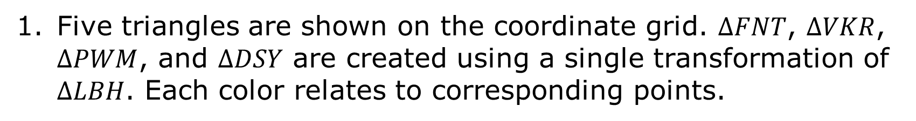
1.7.5 Guided Instruction: Congruence and Similarity Statements
Five triangles are shown on the coordinate grid. $∆FNT$, $∆VKR$, $∆PWM$, and $∆DSY$ are created using a single transformation of $∆LBH$. Each color relates to corresponding points.
volume 1, pg. 46

Slide 24
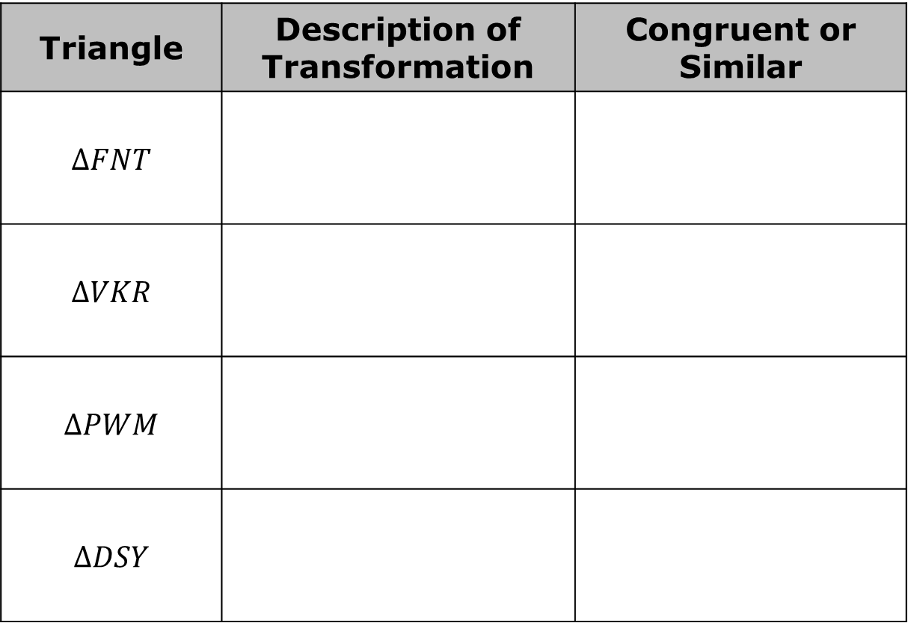
Complete the table.
Triangle | Description of Transformation | Congruent or Similar
$$∆FNT$$
$$∆VKR$$
$$∆PWM$$
$$∆DSY$$
volume 1, pg. 46

Slide 25
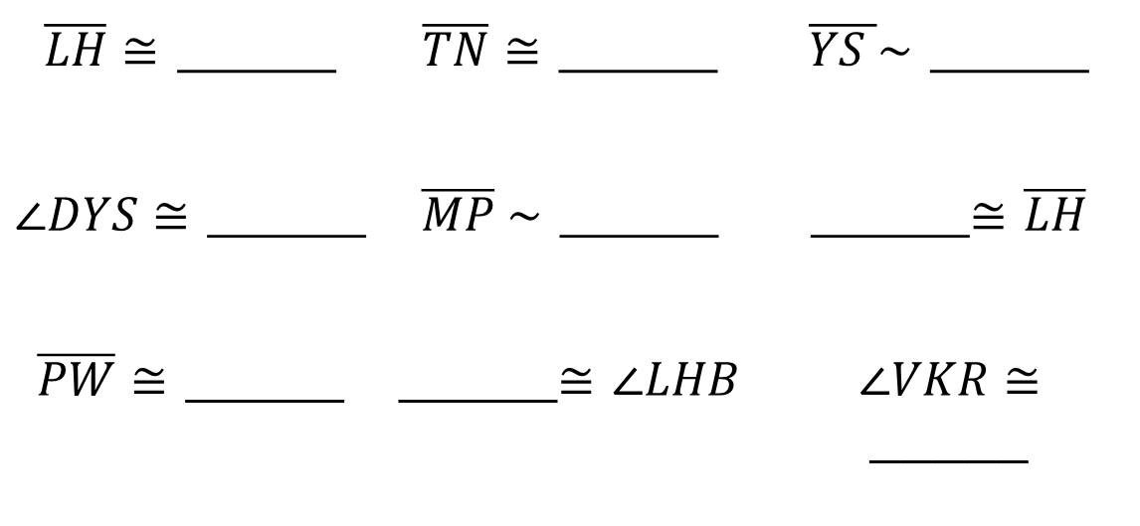
Use the information about the transformations to complete each statement.
Discuss with your partner why there could be multiple answers to each statement. Summarize your discussion.
$\overline{LH}≅$ _____ | $\overline{TN}≅$ _____ | $\overline{YS }\sim$ _____
$∠DYS≅$ _____ | $\overline{MP} \sim$ _____ | _____$≅$ $\overline{LH}$
$\overline{PW}≅$ _____ | _____$≅$ $∠LHB$ | $∠VKR≅$ _____
volume 1, pg. 46

Slide 26

Wrap-Up
volume 1, pg. 47

Slide 27
1.7.6 Wrap-Up: Cool Down
Complete the statements about today’s lesson.
Something I learned today …
I didn’t know …
One question I still have …
volume 1, pg. 47

